Slide 1
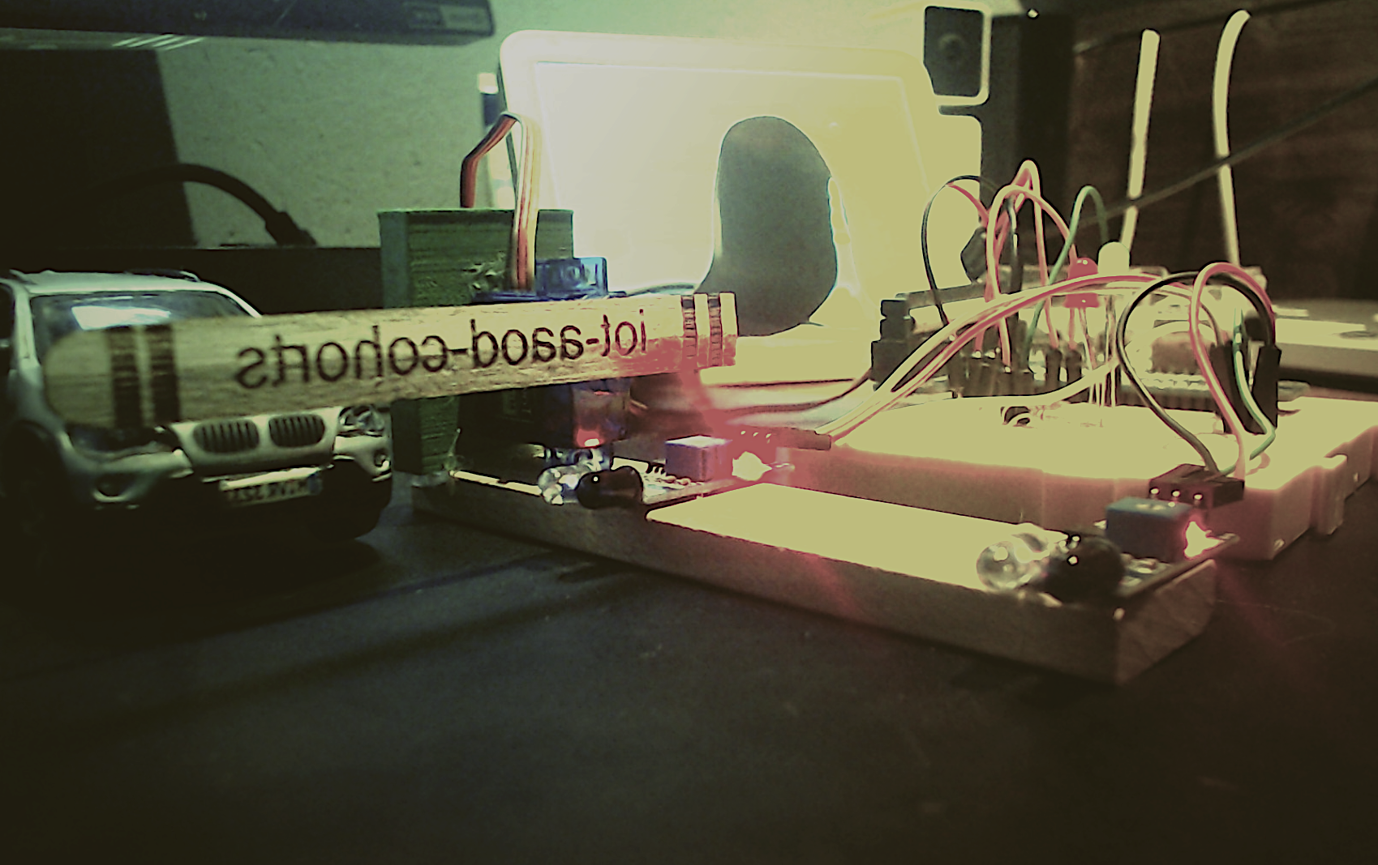
A Gate Controller driven from the Cloud
Jordi Porta
Sr Solutions Architect
Notes:
Spark interest, curiosity

Slide 2
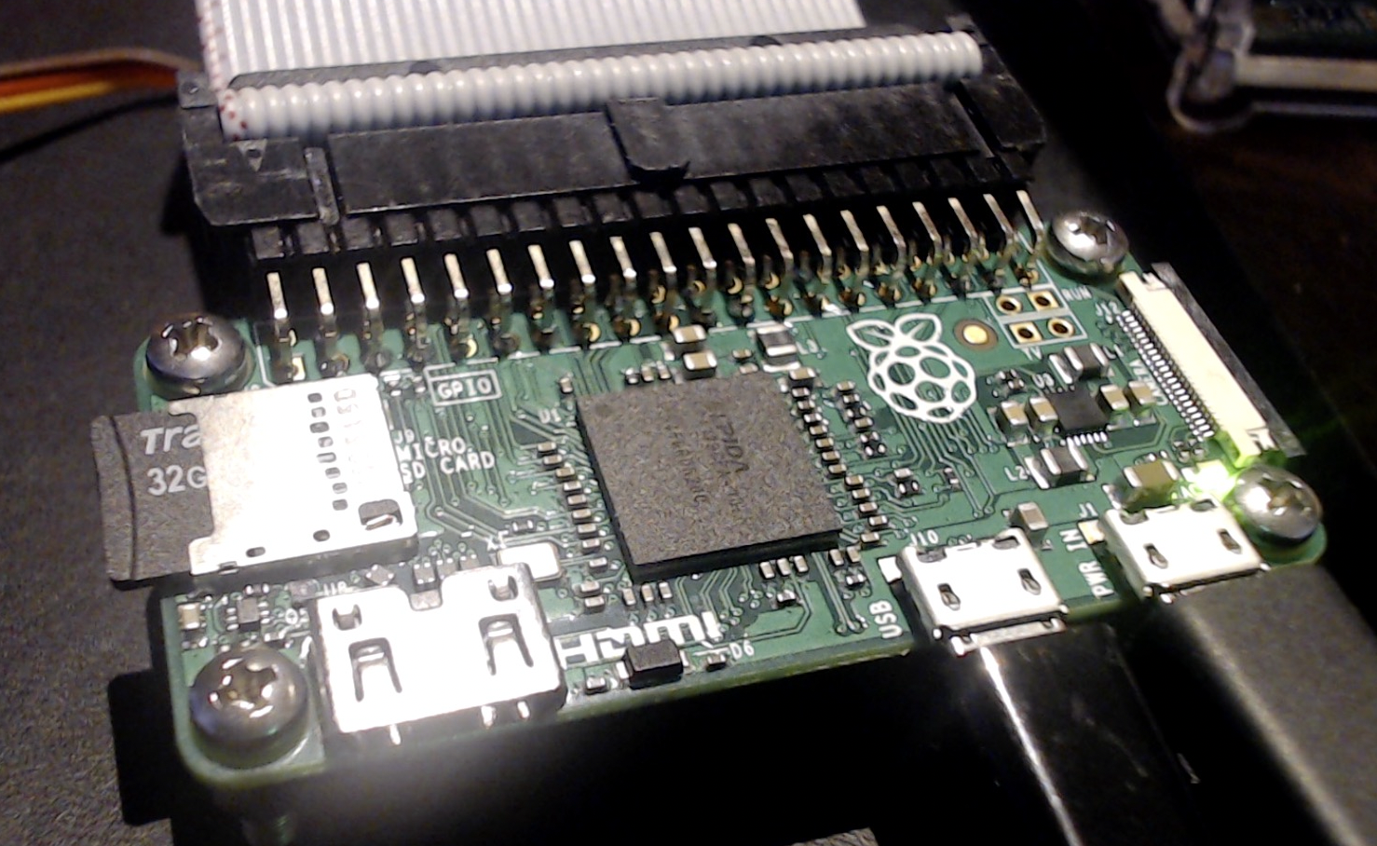
Design Choices
Device
Leverage Greengrass to locally develop and debug applications
Lightweight processes to interface with sensors and actuators
data pushed to, commands received from IoT Core
Cloud
No-Code decision making leveraging IoT Events
Changes take effect immediately (no deployment required)
Each gate is controlled by an independent detector
Notification system in case of anomalies
Raspberry Pi Zero

Slide 3
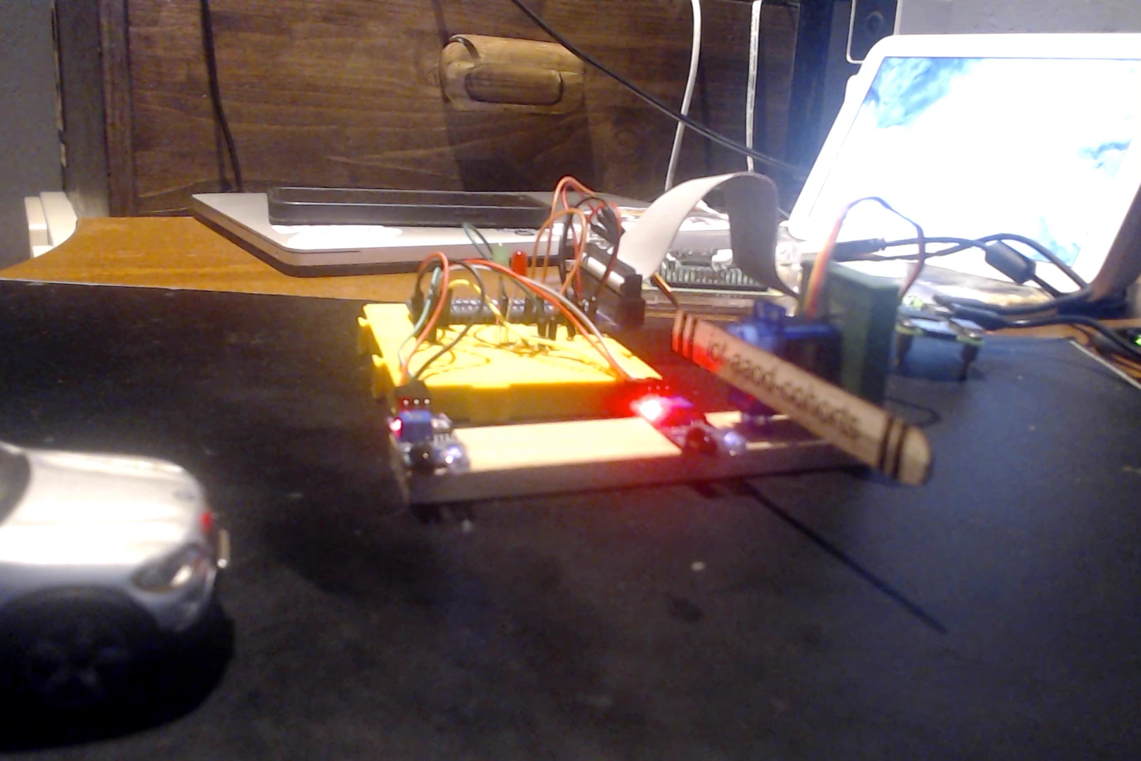
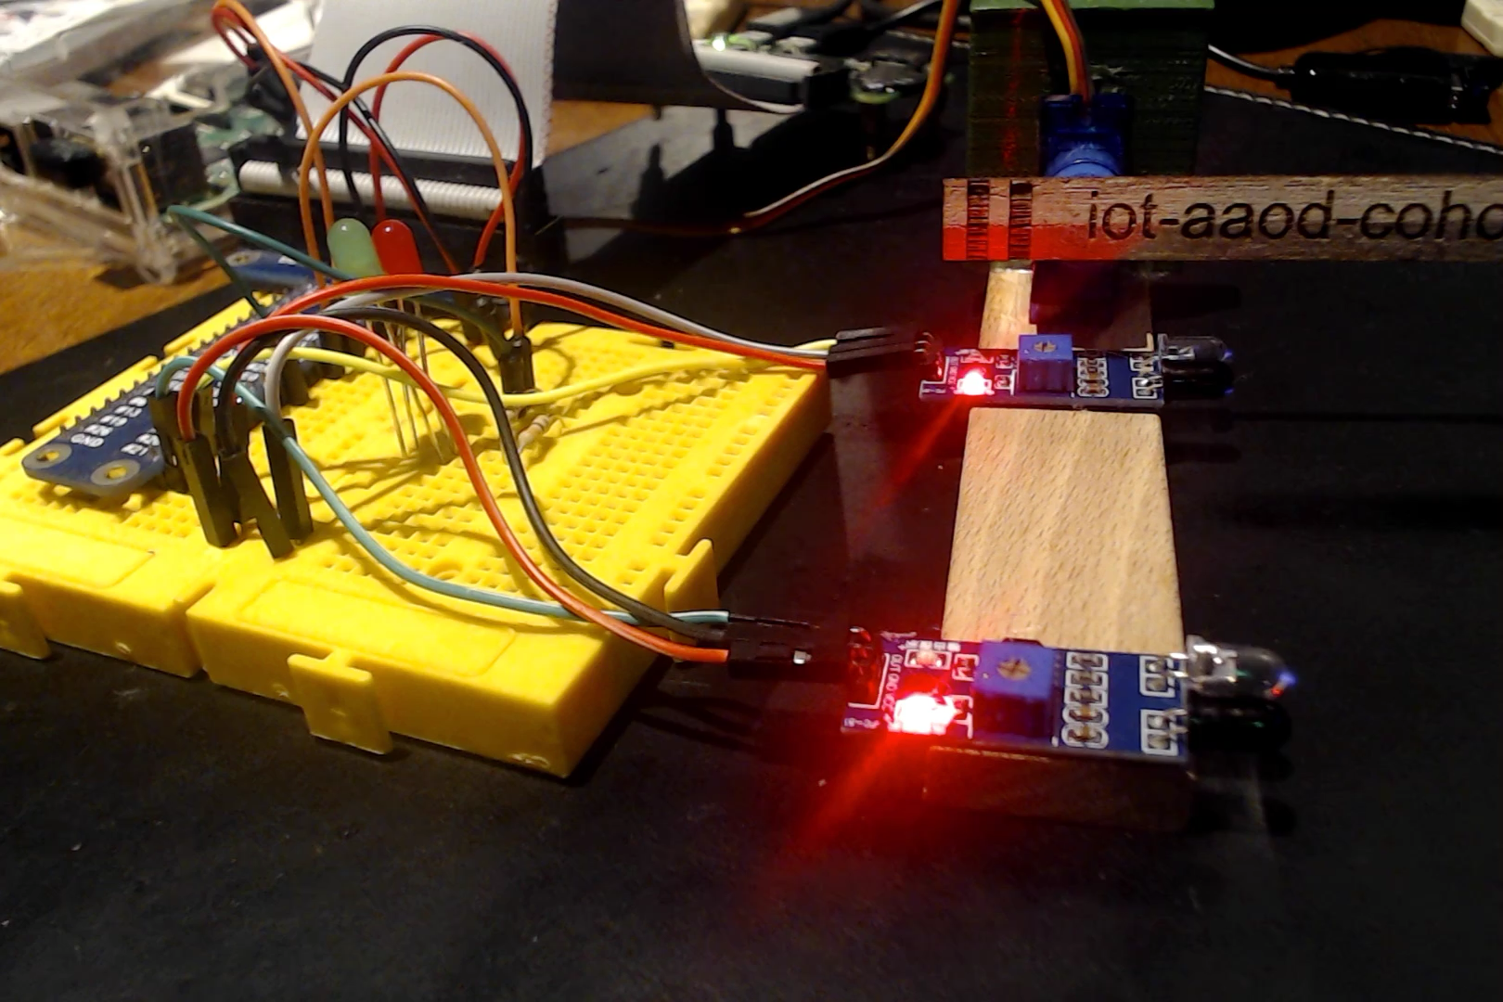
Demo

Slide 4
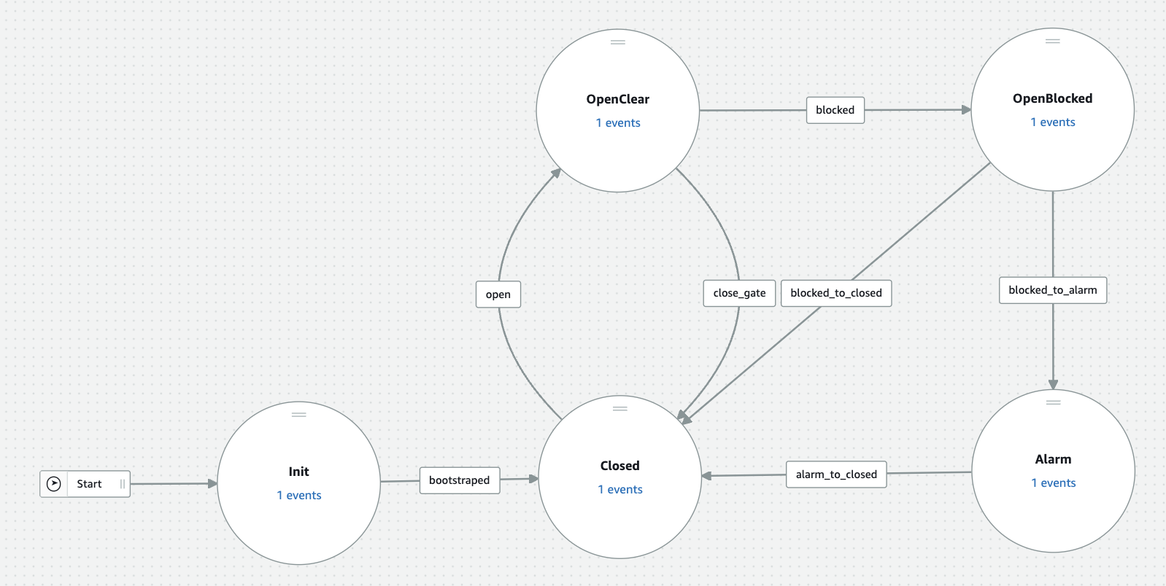
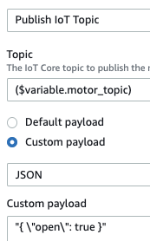
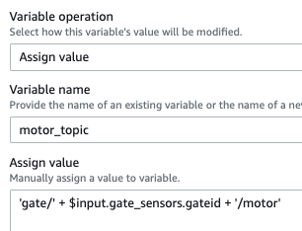
AWS IoT Events – the detector

Slide 5


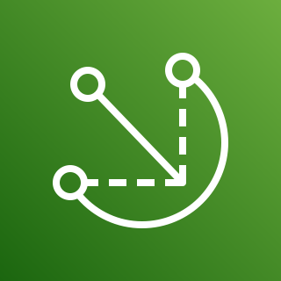

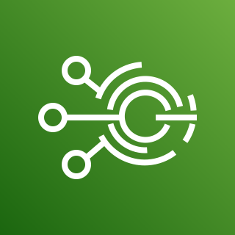


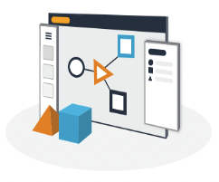

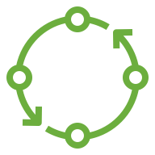

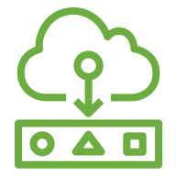
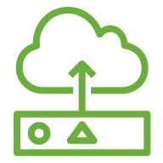


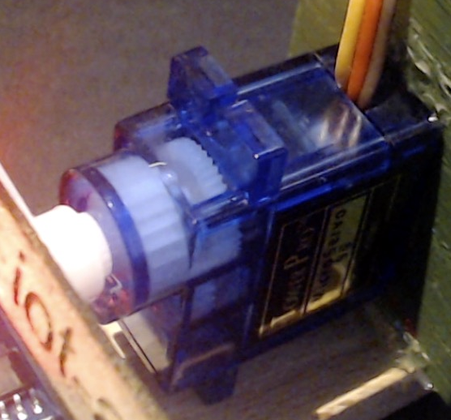
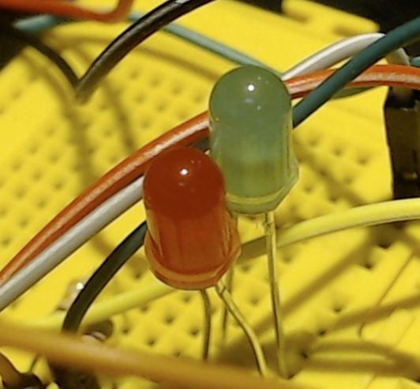
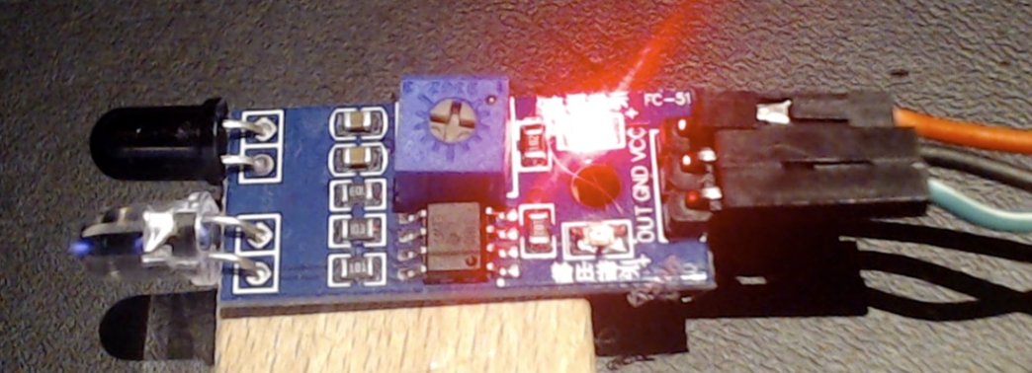
Architecture
Email notification
SMS notification
Amazon SNS
AWS IoT Greengrass
AWS IoT Core
AWS IoT Events
gate/{gateid}/sensors
IoT rule
gate_sensors
Motor Artifact
Leds Artifact
Sensors Artifact
gate/{gateid}/leds
Component
Recipe
Component
Recipe
Component
Recipe
Detector Model
Gate Controller
gate/{gateid}/motor
IoT rule
gate_timeout
motor
green led
red led
IR sensor 1
IR sensor 2
gate/{gateid}/alarm
Timer
AWS Lambda

Slide 6
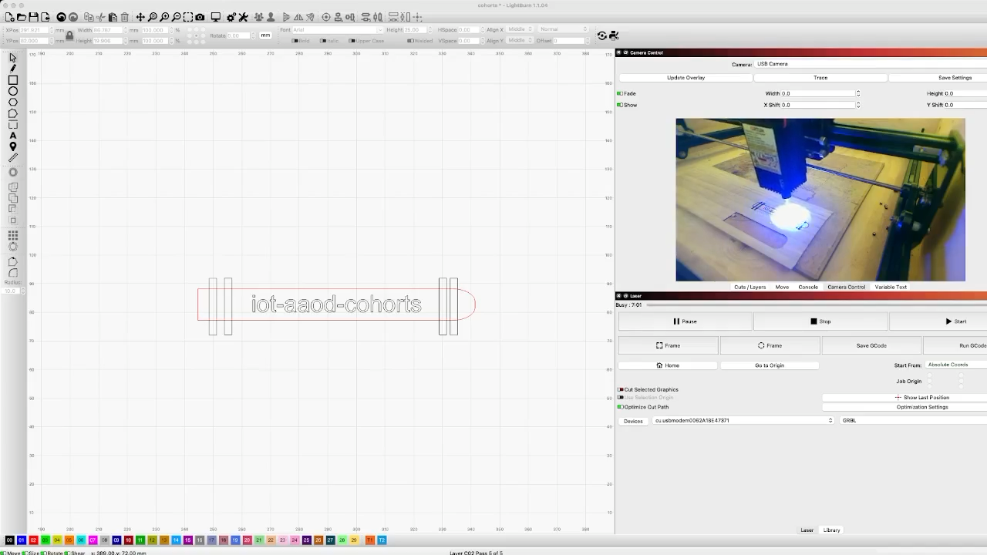
Thank You

